Slide 1
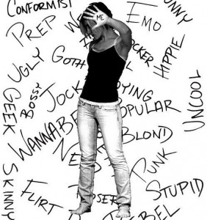
Symbolic Interactionism

Slide 2
History
Mead and Cooley
I and Me
I= interpreter of social ____, relays info to “me”
Me (social self)= ________roles that are determined by interactions with others myself (roles)
https://www.youtube.com/watch?v=7A2GIct0UnQ\ 5min

Slide 3
History
Cooley
Looking ____ Self—
1.Think how you appear to others
2.Make a judgment about how ____think 3.___ that judgment to your self-concept

Slide 4
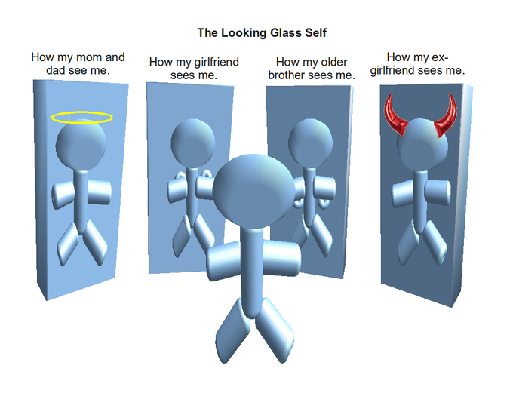

Slide 5


Slide 6
History
Thomas
________ of the situation—you can’t understand human behavior without understanding the perspectives ________ in the interaction. Perception = reality.

Slide 7
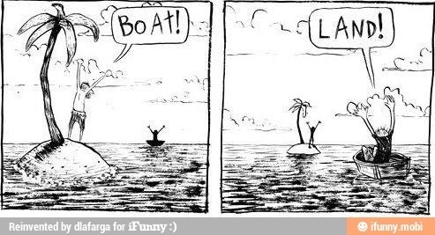

Slide 8
Basic Assumptions
First Overarching theme
Meaning is ______ to human behavior
  People will _____ to something according to the meaning that the thing has for them

Slide 9
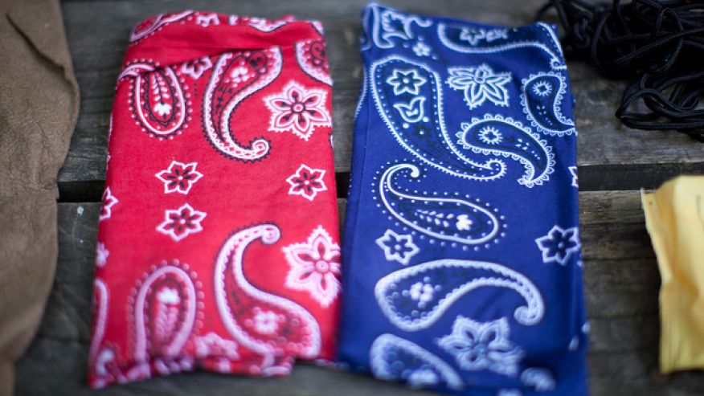

Slide 10


Slide 11
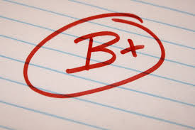

Slide 12
Basic Assumptions
First Overarching theme
  We learn about ______through interactions with others
  What does holding hands mean?
  A kiss?
  How do you know you are in a relationship?
  Cohabiting?

Slide 13
Basic Assumptions Cont.
As people come into _____ with different things and experiences, they ______ what is being learned.
  https://www.youtube.com/watch?v=KX5jNnDMfxA 1min
  What meaning does each person take from this interaction?

Slide 14
Basic Assumptions
Second Overarching Theme
A human infant is asocial.
Prejudices and self-identity are ______.

Slide 15
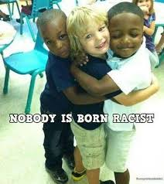

Slide 16
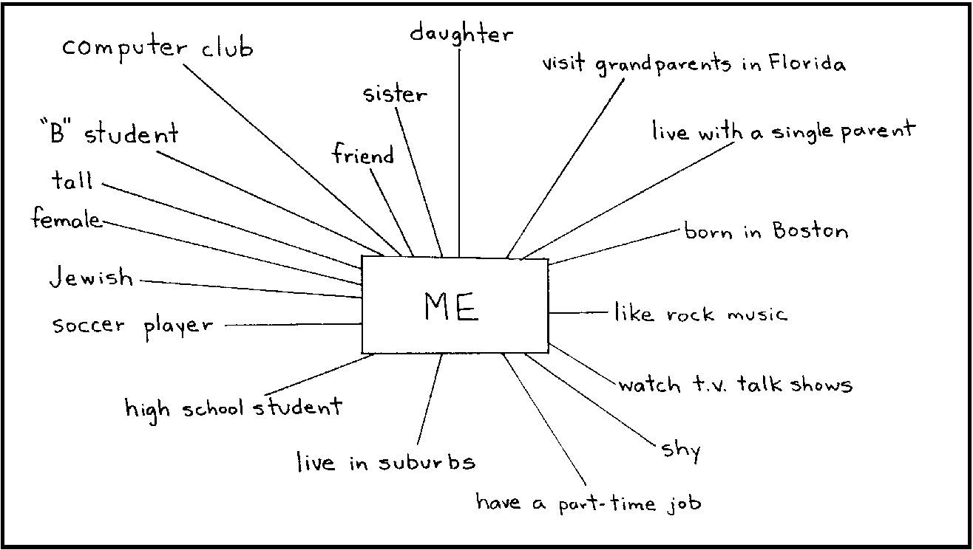
Identity Chart

Slide 17
Basic Assumptions
Second Overarching Theme
Once individuals develop a sense of ____, this will provide motivation for future ______.
A good student
A good instructor
A good bf/gf
A gang-member
A good family member

Slide 18
Basic Assumptions
Third Overarching Theme
Individuals are influenced by ______.
More involved fathers?
Littering?
Other examples?

Slide 19
Basic Assumptions
Third Overarching Theme
People learn the ____ and values of society through everyday interactions within that _____.
Clapping
Eating in public
Breastfeeding
Elevator
Other Examples?

Slide 20
Primary Terms and Concepts
Symbols
Meanings are defined by how we ___ others using them and the _______ of the situation
Dressing Down
Interaction
Social behavior between 2 or more people

Slide 21
Primary Terms and Concepts
Gestures
A OK –different meaning here and Brasil
Social Norms
Appropriate interactions
Rituals
(traditions that are repeated 0ver time)

Slide 22
Primary Terms and Concepts
Roles
A set of defined social _____ for a specific situation.
What are your roles?
Salience
How important each ____ is to you right now

Slide 23
Primary Terms and Concepts
Identity
The roles that are most ______ for us make up our identities
  How do your salient roles influence your behavior?

Slide 24
Some Application Questions
Describe a situation similar to the cocktail party at the beginning of the book chapter.
Describe the setting or definition of the situation.

Slide 25
Some Application Questions
Wife’s grad school end of year party; some visitors from Vietnam
How did you react? Not happy to be there but put on a happy face because that is how my wife and the people at the party expected me to act. Learned to say goodbye in Vietnamese.

Slide 26
Application Question
How did the other people respond? As expected, very pleased and surprised when I said good bye to them in Vietnamese. Wife was happy I put on a good show.

Slide 27
Application Question
How does this influence my behavior?
I will continue to put on a happy face for my wife and learn how to say hello and goodbye in multiple languages.

Slide 28
Methodological Issue
Can be used for both quantitative and qualitative research

Slide 29
Critique
1—Initially hard to define and _______ concepts but this has been overcome
2—Key concepts ___ combined into one theory—can pick and choose what parts of the theory to use

Slide 30
Critique
3—Role of ______ are undervalued and unconscious ignored—somewhat addressed now
4—Overemphasis on one’s ability to create one’s own reality and ______ the actual physical world we live in.

Slide 31
Critique
5—The role of _____ is ignored—one perception may have more power and thus be reinforced
6—The role of _____ is largely ignored
7—Symbolic Interactionism is a framework for understanding rather than a stand-alone theory

Slide 32
Review
Summary from a more sociological perspective (3:33)
http://www.youtube.com/watch?v=jFQIIM8IRZU

Slide 33
Application
Catfished Story (10:53)
https://www.youtube.com/watch?v=KeStsES1o3M\
Full Catfished Episode (40:50)
http://www.hulu.com/welcome

